Slide 1
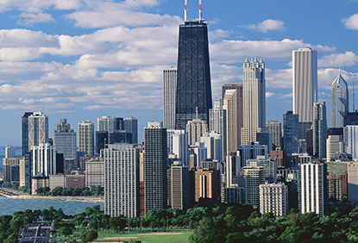
Living in Chicago Chicago Booth First Day
Partner Presentation

Slide 2
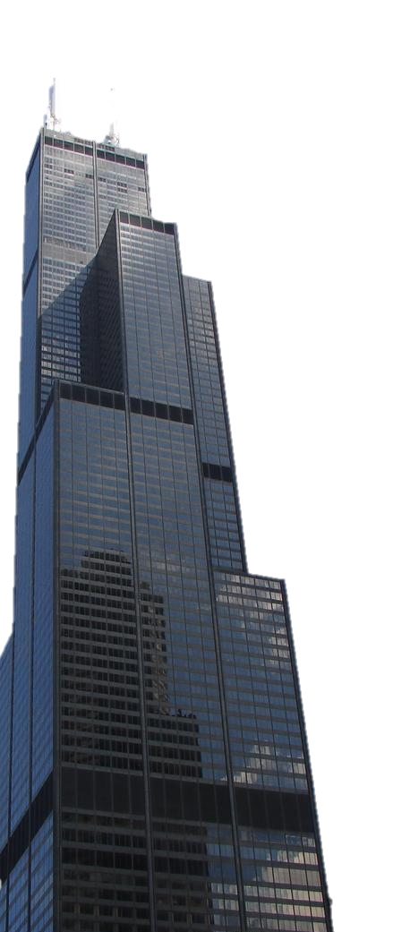
Living in Chicago: The Basics
Chicago is home to...
237 square miles of land
An estimated 2,695,598 residents
77 community areas / more than 100 neighborhoods
Dozens of cultural institutions, historical sites and museums
More than 200 theaters
Nearly 200 art galleries
More than 7,300 restaurants
26 miles of lakefront
15 miles of beaches
36 annual parades
19 miles of lakefront bicycle paths
552 parks

Slide 3
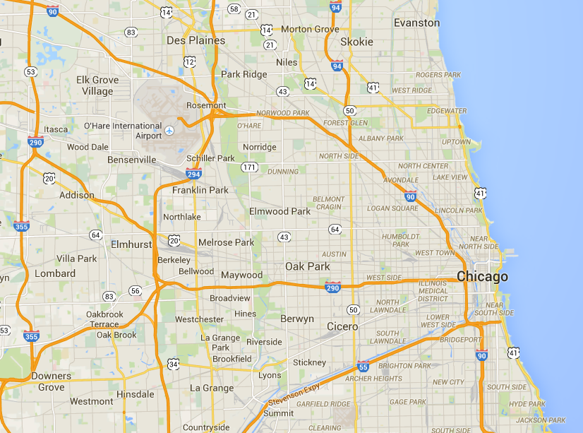
Living in Chicago: Where am I?
O’Hare
Gleacher
Navy Pier
“The Bean”
Midway
Booth

Slide 4
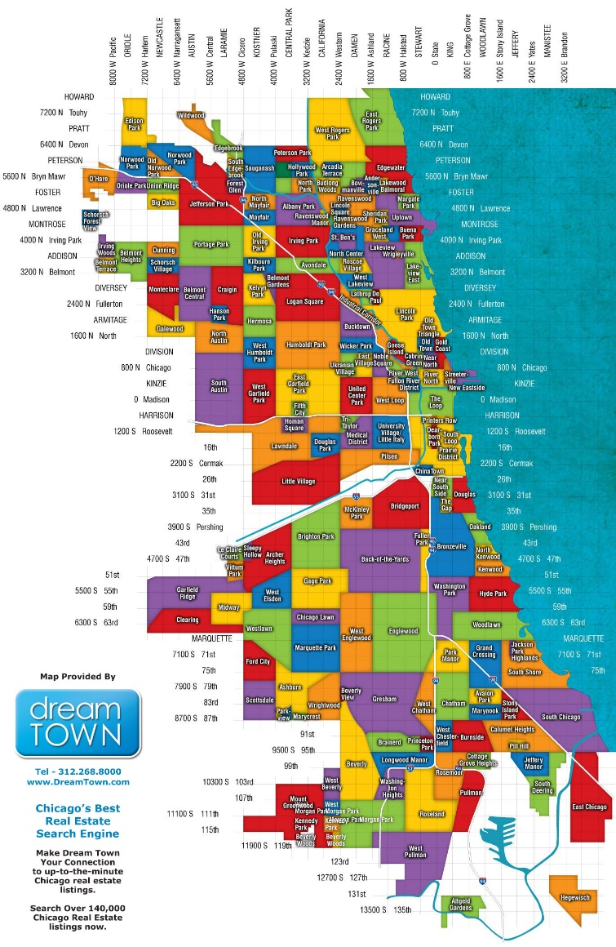
Living in Chicago: Neighborhood Overview
Albany Park
Altgeld Gardens
Andersonville
Archer Heights
Armour Square
Ashburn
Ashburn Estates
Auburn Gresham
Avalon Park
Avondale
Avondale Gardens
Back of the Yards
Belmont Central
Belmont Gardens
Belmont Heights
Belmont Terrace
Beverly
Beverly View
Beverly Woods
Big Oaks
Boystown
Bowmanville
Brainerd
Brickyard
Bridgeport
Brighton Park
Bronzeville
Bucktown
Budlong Woods
Buena Park
Burnside
Cabrini–Green
Calumet Heights
Canaryville
Central Station
Chatham
Chicago Lawn
Chinatown
Chrysler Village
Clarendon Park
Clearing East
Clearing West
Cottage Grove Heights
Cragin
Crestline
Dearborn Homes
Dearborn Park
Douglas Park
Dunning
East Beverly
East Chatham
East Garfield Park
East Hyde Park
East Pilsen
East Side
East Village
Eden Green
Edgebrook
Edgewater
Edgewater Beach
Edgewater Glen
Edison Park
Englewood
Fernwood
Fifth City
Ford City
Forest Glen
Fuller Park
Fulton River District
Gage Park
Galewood
The Gap
Garfield Ridge
Gladstone Park
Gold Coast
Golden Gate
Goose Island
Graceland West
Grand Boulevard
Grand Crossing
Greater Grand Crossing
Greektown
Gresham
Groveland Park
Hamilton Park
Hanson Park
Heart of Chicago
Hegewisch
Hermosa
Hollywood Park
Homan Square
Humboldt Park
Hyde Park
Illinois Medical District
Irving Park
Irving Woods
The Island
Jackowo
Jackson Park Highlands
Jefferson Park
K-Town
Kelvyn Park
Kennedy Park
Kensington
Kenwood
Kilbourn Park
Kosciuszko Park (The Land of Koz)
Lake Meadows
Lake View
Lake View East
Lakewood / Balmoral
LeClaire Courts
Legends South (Robert Taylor Homes)
Lilydale
Lincoln Park
Lincoln Square
Lithuanian Plaza
Little Italy
Little Village
Logan Square
Longwood Manor
The Loop
Lower West Side
Loyola
Magnificent Mile
Margate Park
Marquette Park
Marshall Square
Marynook
Mayfair
McKinley Park
Merchant Park
Montclare
Morgan Park
Mount Greenwood
Museum Campus
Near East Side
Near North Side
Near West Side
New Chinatown
New City
Noble Square
North Austin
North Center
North Halsted
North Kenwood
North Lawndale
North Mayfair
North Park
Nortown
Norwood Park East
Norwood Park West
Oakland
O'Hare
Old Edgebrook
Old Irving Park
Old Norwood
Old Town
Old Town Triangle
Oriole Park
Palmer Square
Park Manor
Park West
Parkview
Peterson Park
Pill Hill
Pilsen
Polish Downtown
Polish Village
Portage Park
Prairie Avenue Historic District
Prairie Shores
Princeton Park
Printer's Row
Pulaski Park
Pullman
Ranch Triangle
Ravenswood
Ravenswood Gardens
Ravenswood Manor
River North
River West
River's Edge
Riverdale
Rogers Park
Roscoe Village
Rosehill
Roseland
Rosemoor
Saint Ben's
Sauganash
Schorsch Forest View
Schorsch Village
Scottsdale
Sheffield Neighbors
Sheridan Park
Sleepy Hollow
Smith Park
South Austin
South Chicago
South Commons
South Deering
South East Ravenswood
South Edgebrook
South Lawndale
South Loop
South Shore
Stateway Gardens
Stony Island Park
Streeterville
Talley's Corner
Tri-Taylor
Ukrainian Village
Union Ridge
University Village
Uptown
The Villa
Vittum Park
Wacławowo
Washington Heights
Washington Park
Wentworth Gardens
West Beverly
West Chatham
West Chesterfield
West DePaul
West Elsdon
West Englewood
West Garfield Park
West Humboldt Park
West Lakeview
West Lawn
West Loop
West Morgan Park
West Pullman
West Ridge
West Rogers Park
West Town
West Woodlawn
Wicker Park
Wildwood
Woodlawn
Wrightwood
Wrightwood Neighbors
Wrigleyville

Slide 5
Living in Chicago: Focus Area

Slide 6
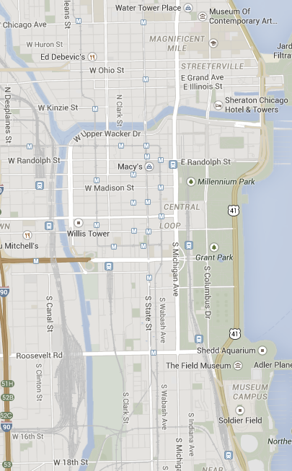
Chicago Booth Living: Overview
Neighborhood | Approx. Boothies
Downtown | The Loop | 60%
South Loop | 12%
Streeterville | Gold Coast | River North | 11%
Hyde Park | 7%
Other neighborhoods | 10%
River North
Gold
Coast
Streeterville
Gleacher Center
Downtown
The Loop
Metra station
It is estimated that more than 90% of the students live away from Hyde Park. This means taking an 18 minute Metra ride to Booth for class. However, living in the city provides an opportunity to be closer to restaurants, shops, bars, and most importantly other Boothies. Gleacher Center, our downtown campus, also holds evening class sections and has plenty of study-group rooms available.
South Loop
Hyde Park

Slide 7
Downtown | The Loop (60% of Students)
Options: Rental apartments, high rises
Vibe: Singles (MPP, Aqua), young couples with babies or no children (Columbus Plaza, Coast, The Tides, The Shoreham, Park Millennium)
Commute:
10 min. walk, 18 min. Metra
Rent (1B): $1,600+
Gleacher Center
Downtown
The Loop
Metra station
Hyde Park

Slide 8
South Loop (12% of Students)
Options: Family friendly condo buildings, high rise apartments
Vibe: Couples and young families
Commute:
5-10 min. walk, 15 min. Metra
35 min Bus
Rent (1B): $1,500+
Gleacher Center
Metra station
South Loop
Hyde Park

Slide 9
Gold Coast | Streeterville (~10% of Students)
Options: Upscale condos, high rise apartments
Vibe: Singles, young couples with babies or no children
Commute:
35-40 minute bus
Drive
15 min. walk, 18 min. Metra
Rent (1B): $2,000+
Gold
Coast
Streeterville
Gleacher Center
Metra station
Hyde Park

Slide 10
River North (5-10% of Students)
Options: Upscale apartments and condos
Vibe: Singles, young couples with no children (tons of bars and restaurants)
Commute:
35-40 minute bus
Drive
15 min. walk, 18 min. Metra
Rent (1B): $2,000+
River North
Gleacher Center
Metra station
Hyde Park

Slide 11
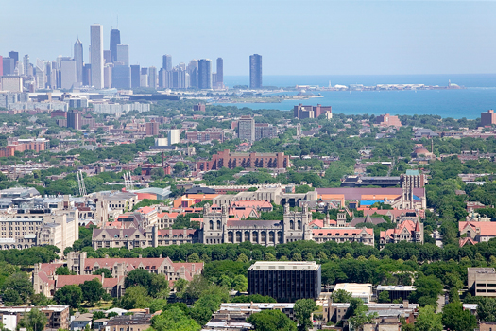
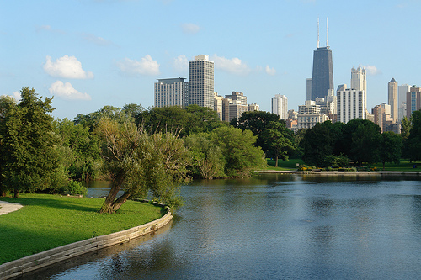
Other Neighborhoods (10-15% of Students)
Hyde Park (7%)
Options: Duplex buildings and houses
Vibe: Undergrad students, other grad students, professors and families
Commute: 5-15 min. walk
Rent (1B): $1,000+
Lincoln Park | Wicker Park | Logan Sq. (7%)
Options: Duplex buildings, cafés, restaurants, bars
Vibe: Hipsters: Wicker Park, Logan Square
Young families: Lincoln Park
Commute: 30-45 min. drive or 75 min. by public transportation
Rent (1B): $1,300+

Slide 12
Additional Considerations
Some additional things to consider…
Parking (Included? Cost to rent?)
Proximity to public transportation
Utilities (Included?)
Washer/Dryer (In-unit –or – community?)
Renter’s Insurance
Schools
Pets (Restrictions?)
Amenities (Gym? Pool? Classes? Party room?)
Lease term: 12 months / 24 months
Snow removal (if not in high rise / condo)
Proximity to night life / restaurants / cultural events

Slide 13
Questions?

